Slide 1

Principles of Human Computer Interaction . ITIS 6400-8400 . Fall 2016
By: Rahul Rachapalli, Alex Nelson, Lina Taheri, Maryam Tavakoli Hosseinabadi, and Rob Frye

Slide 2
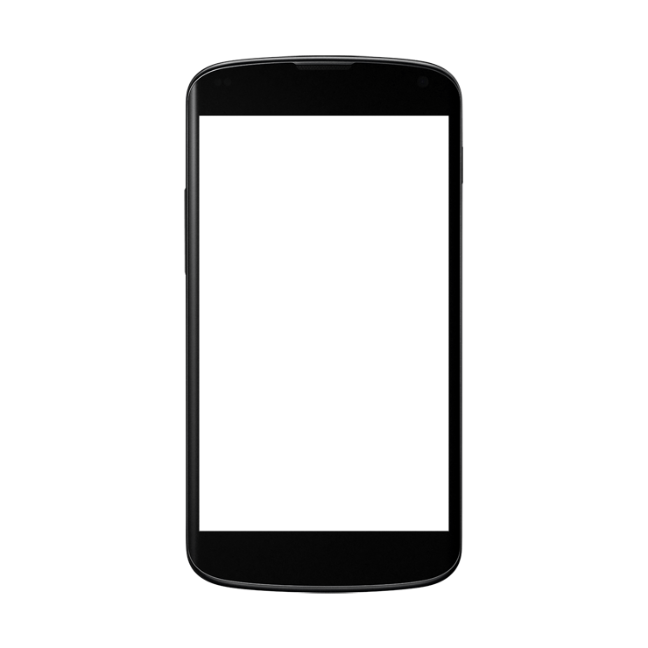
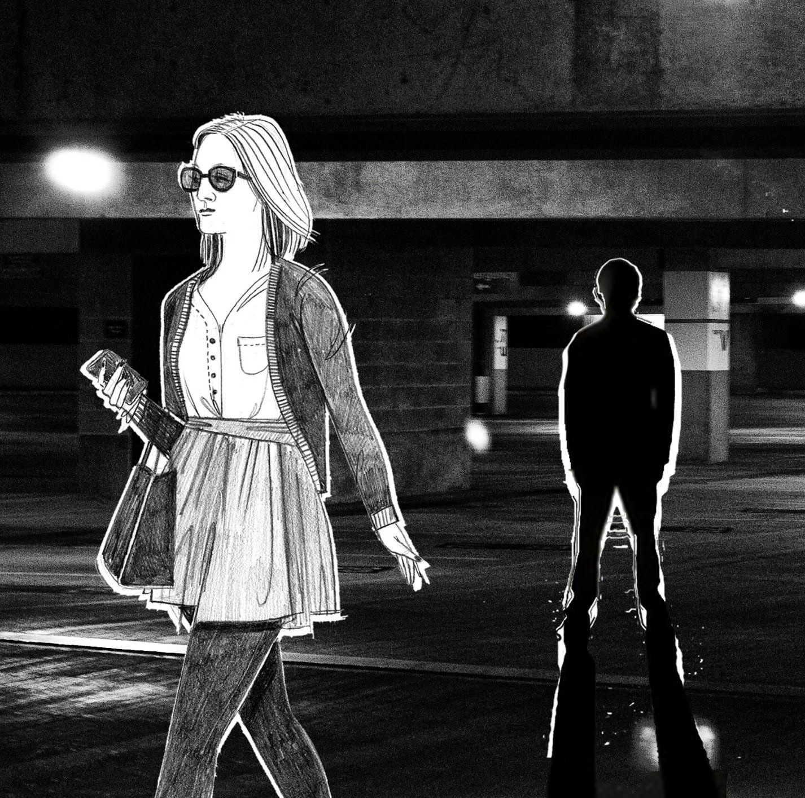
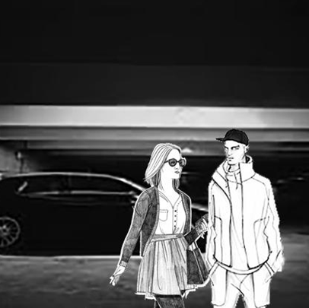
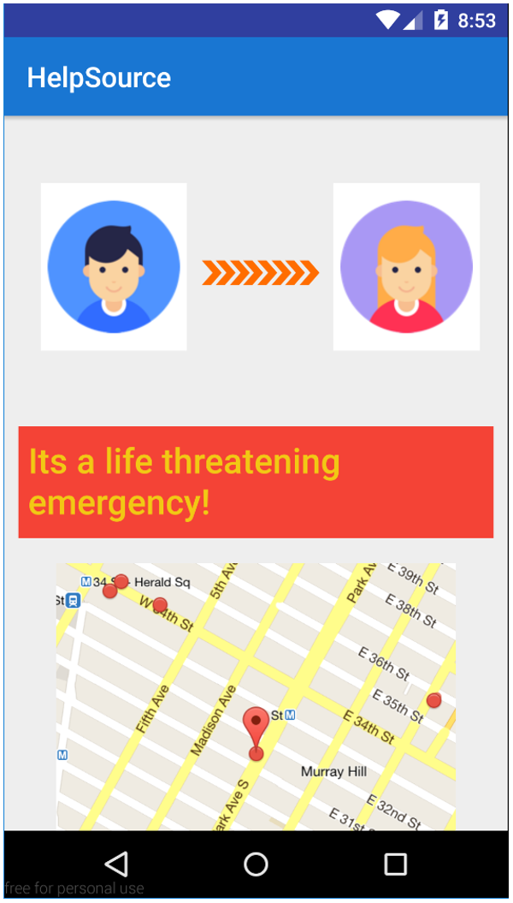
INTRODUCTION
Jim
Please help! I don’t feel safe. Here’s my location. Hurry!
A lot of us take personal safety for granted. But the reality is that bad things can happen, so it's important to always be prepared.
With Help Source, an app on your smartphone, you can now feel comforted knowing that you'll never be alone.

Slide 3
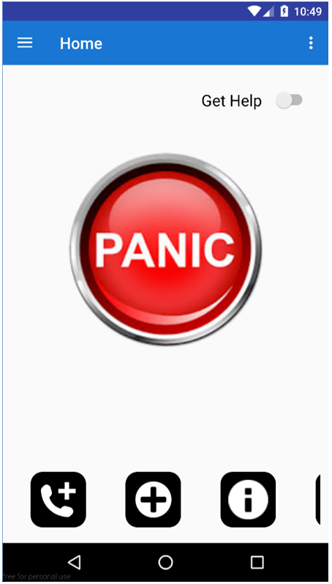
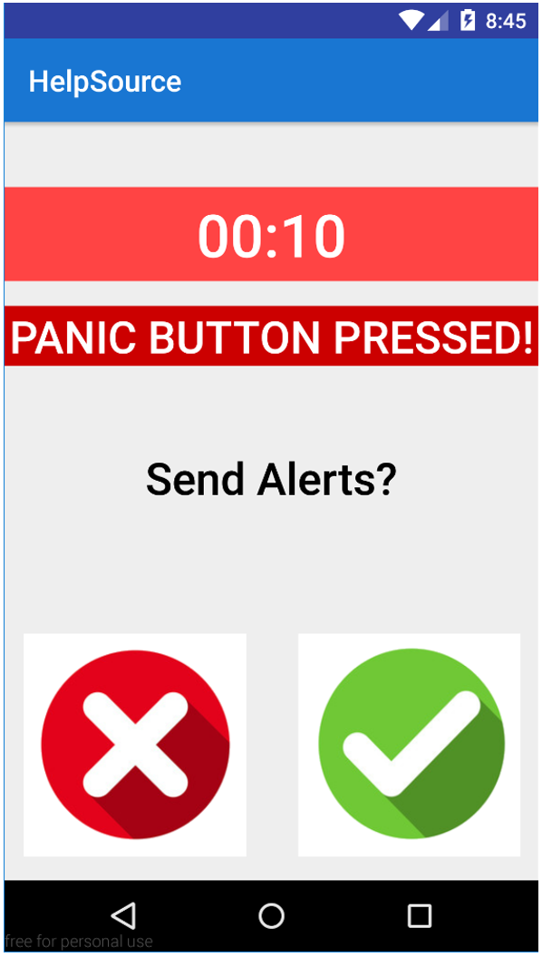
GET HELP // Design Goal 1
Jim
Please help! I don’t feel safe. Here’s my location. Hurry!
Tap “PANIC” Button
Tap check to send alert
Sending alert to contact

Slide 4
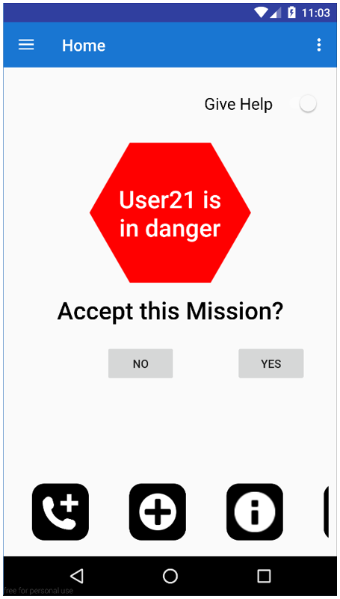
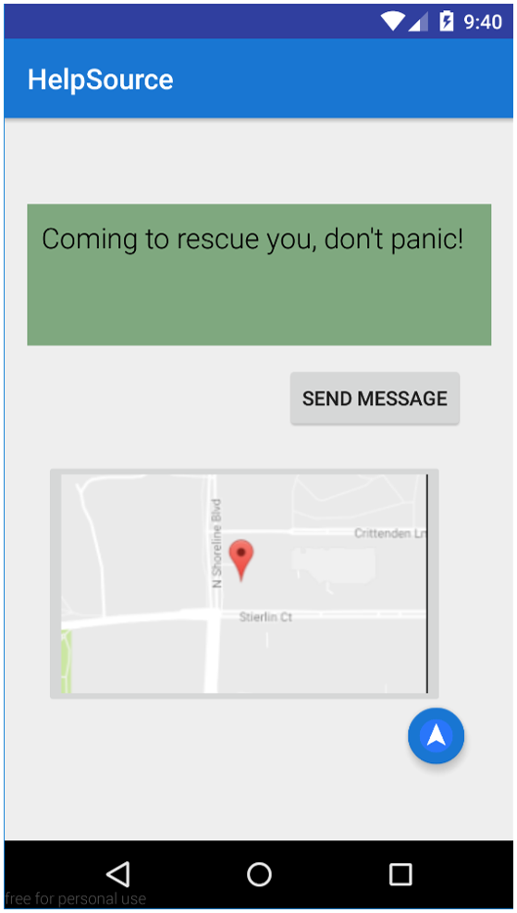
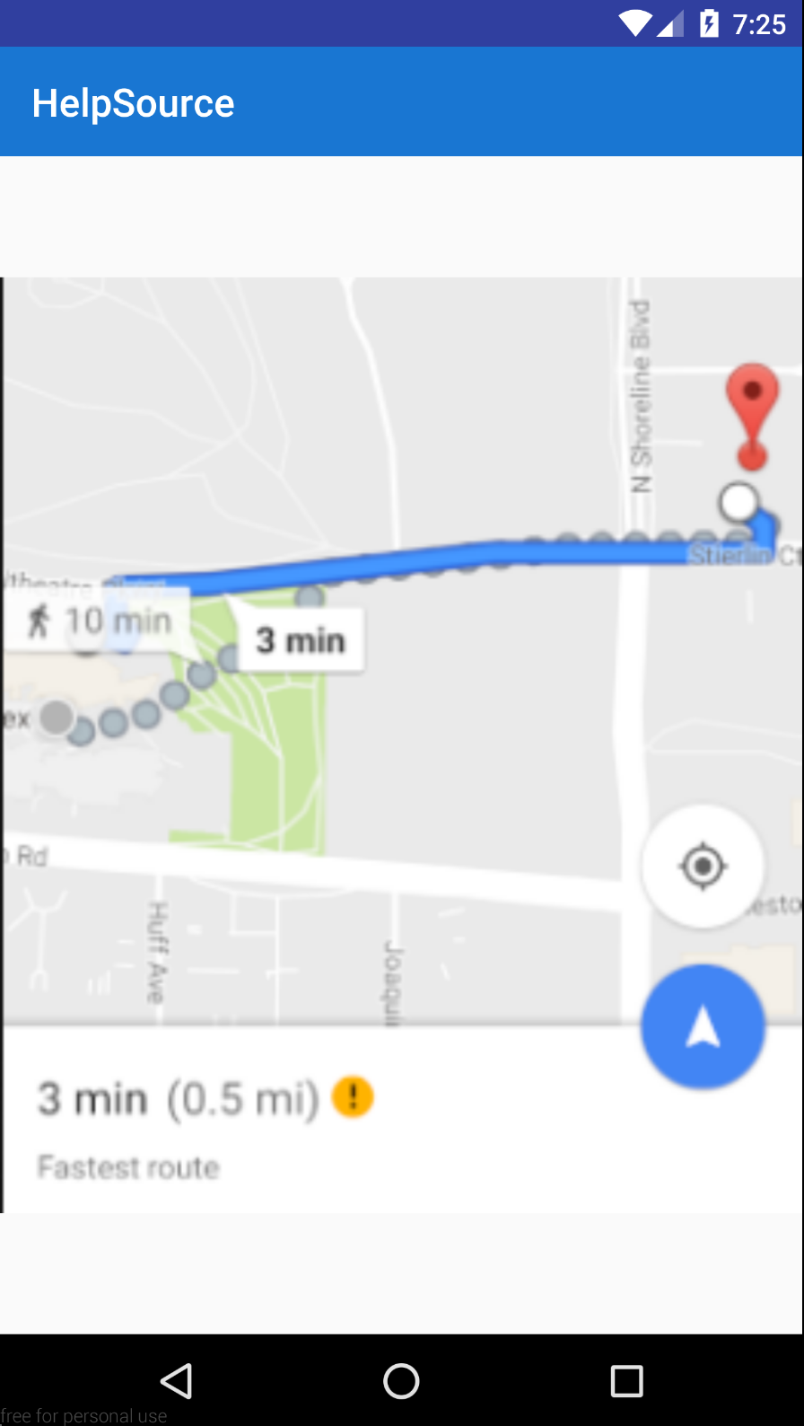
GIVE HELP // Design Goal 2
Click “YES” to
accept the mission
Send Message that you are on your way
View directions to locate user in need of help

Slide 5
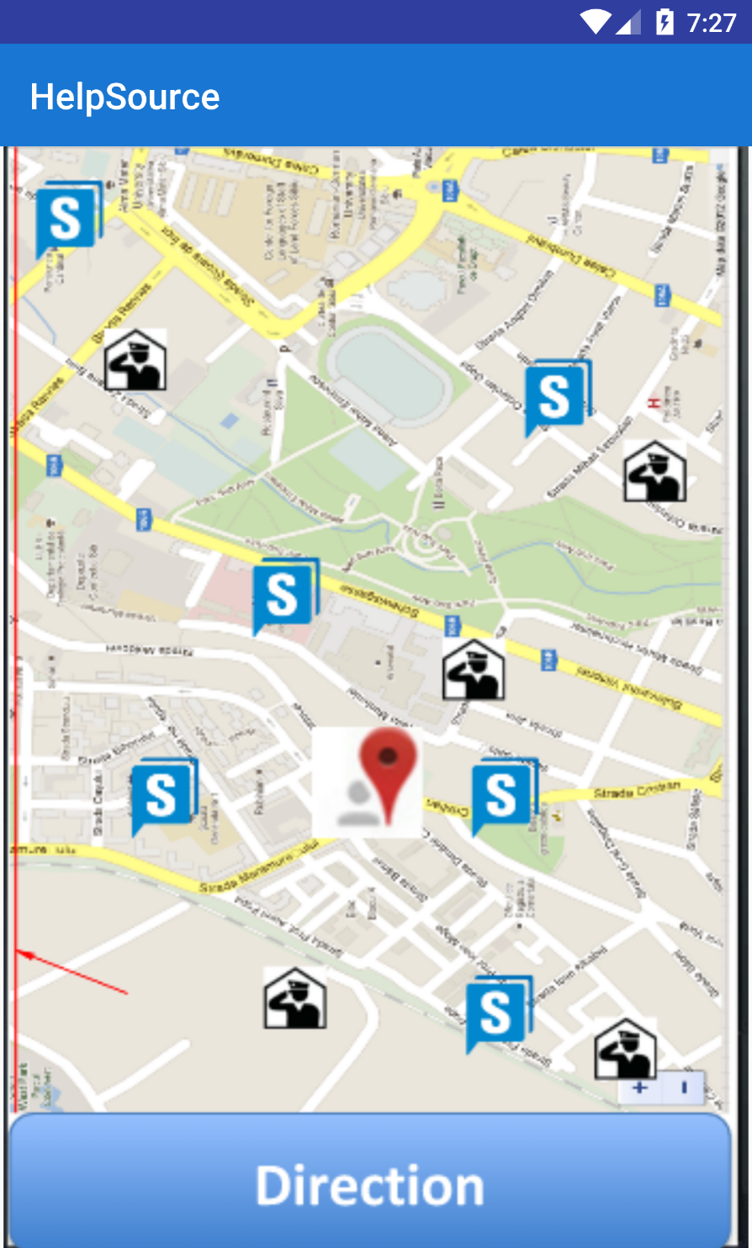
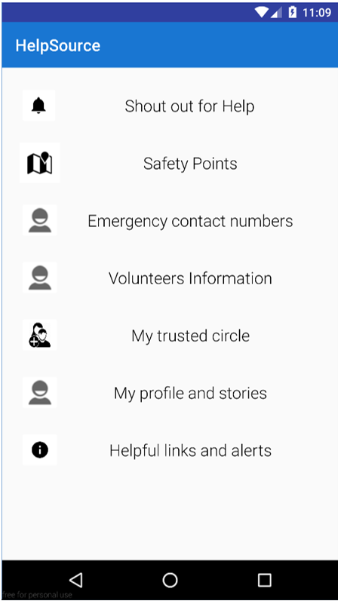
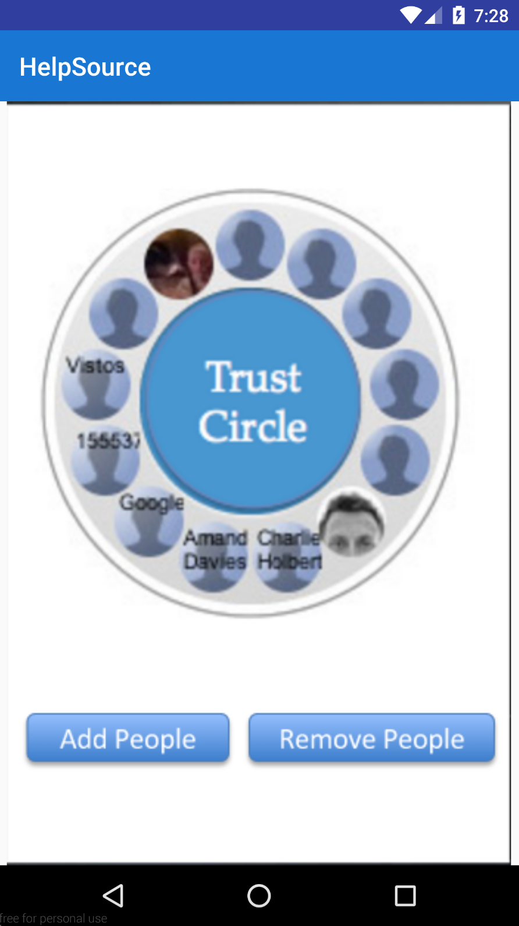
GET INFO // Design Goal 3
“Safety Points”
Information Resources
“My trusted circle”

Slide 6
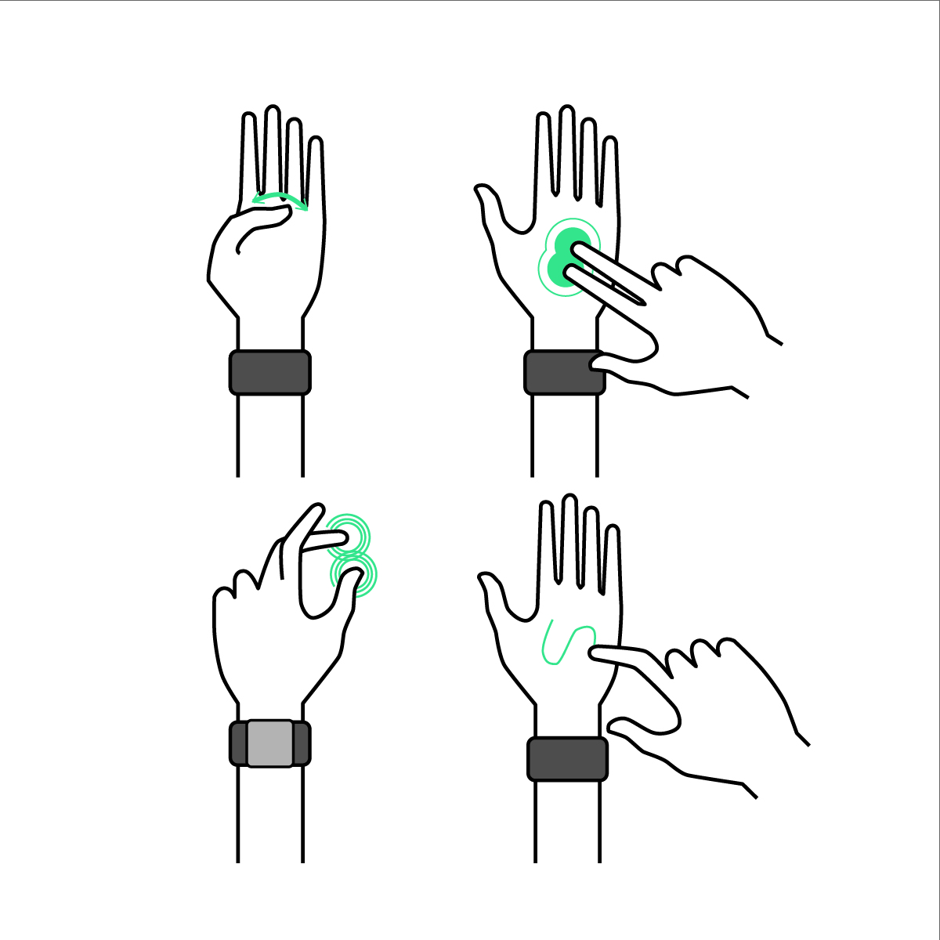
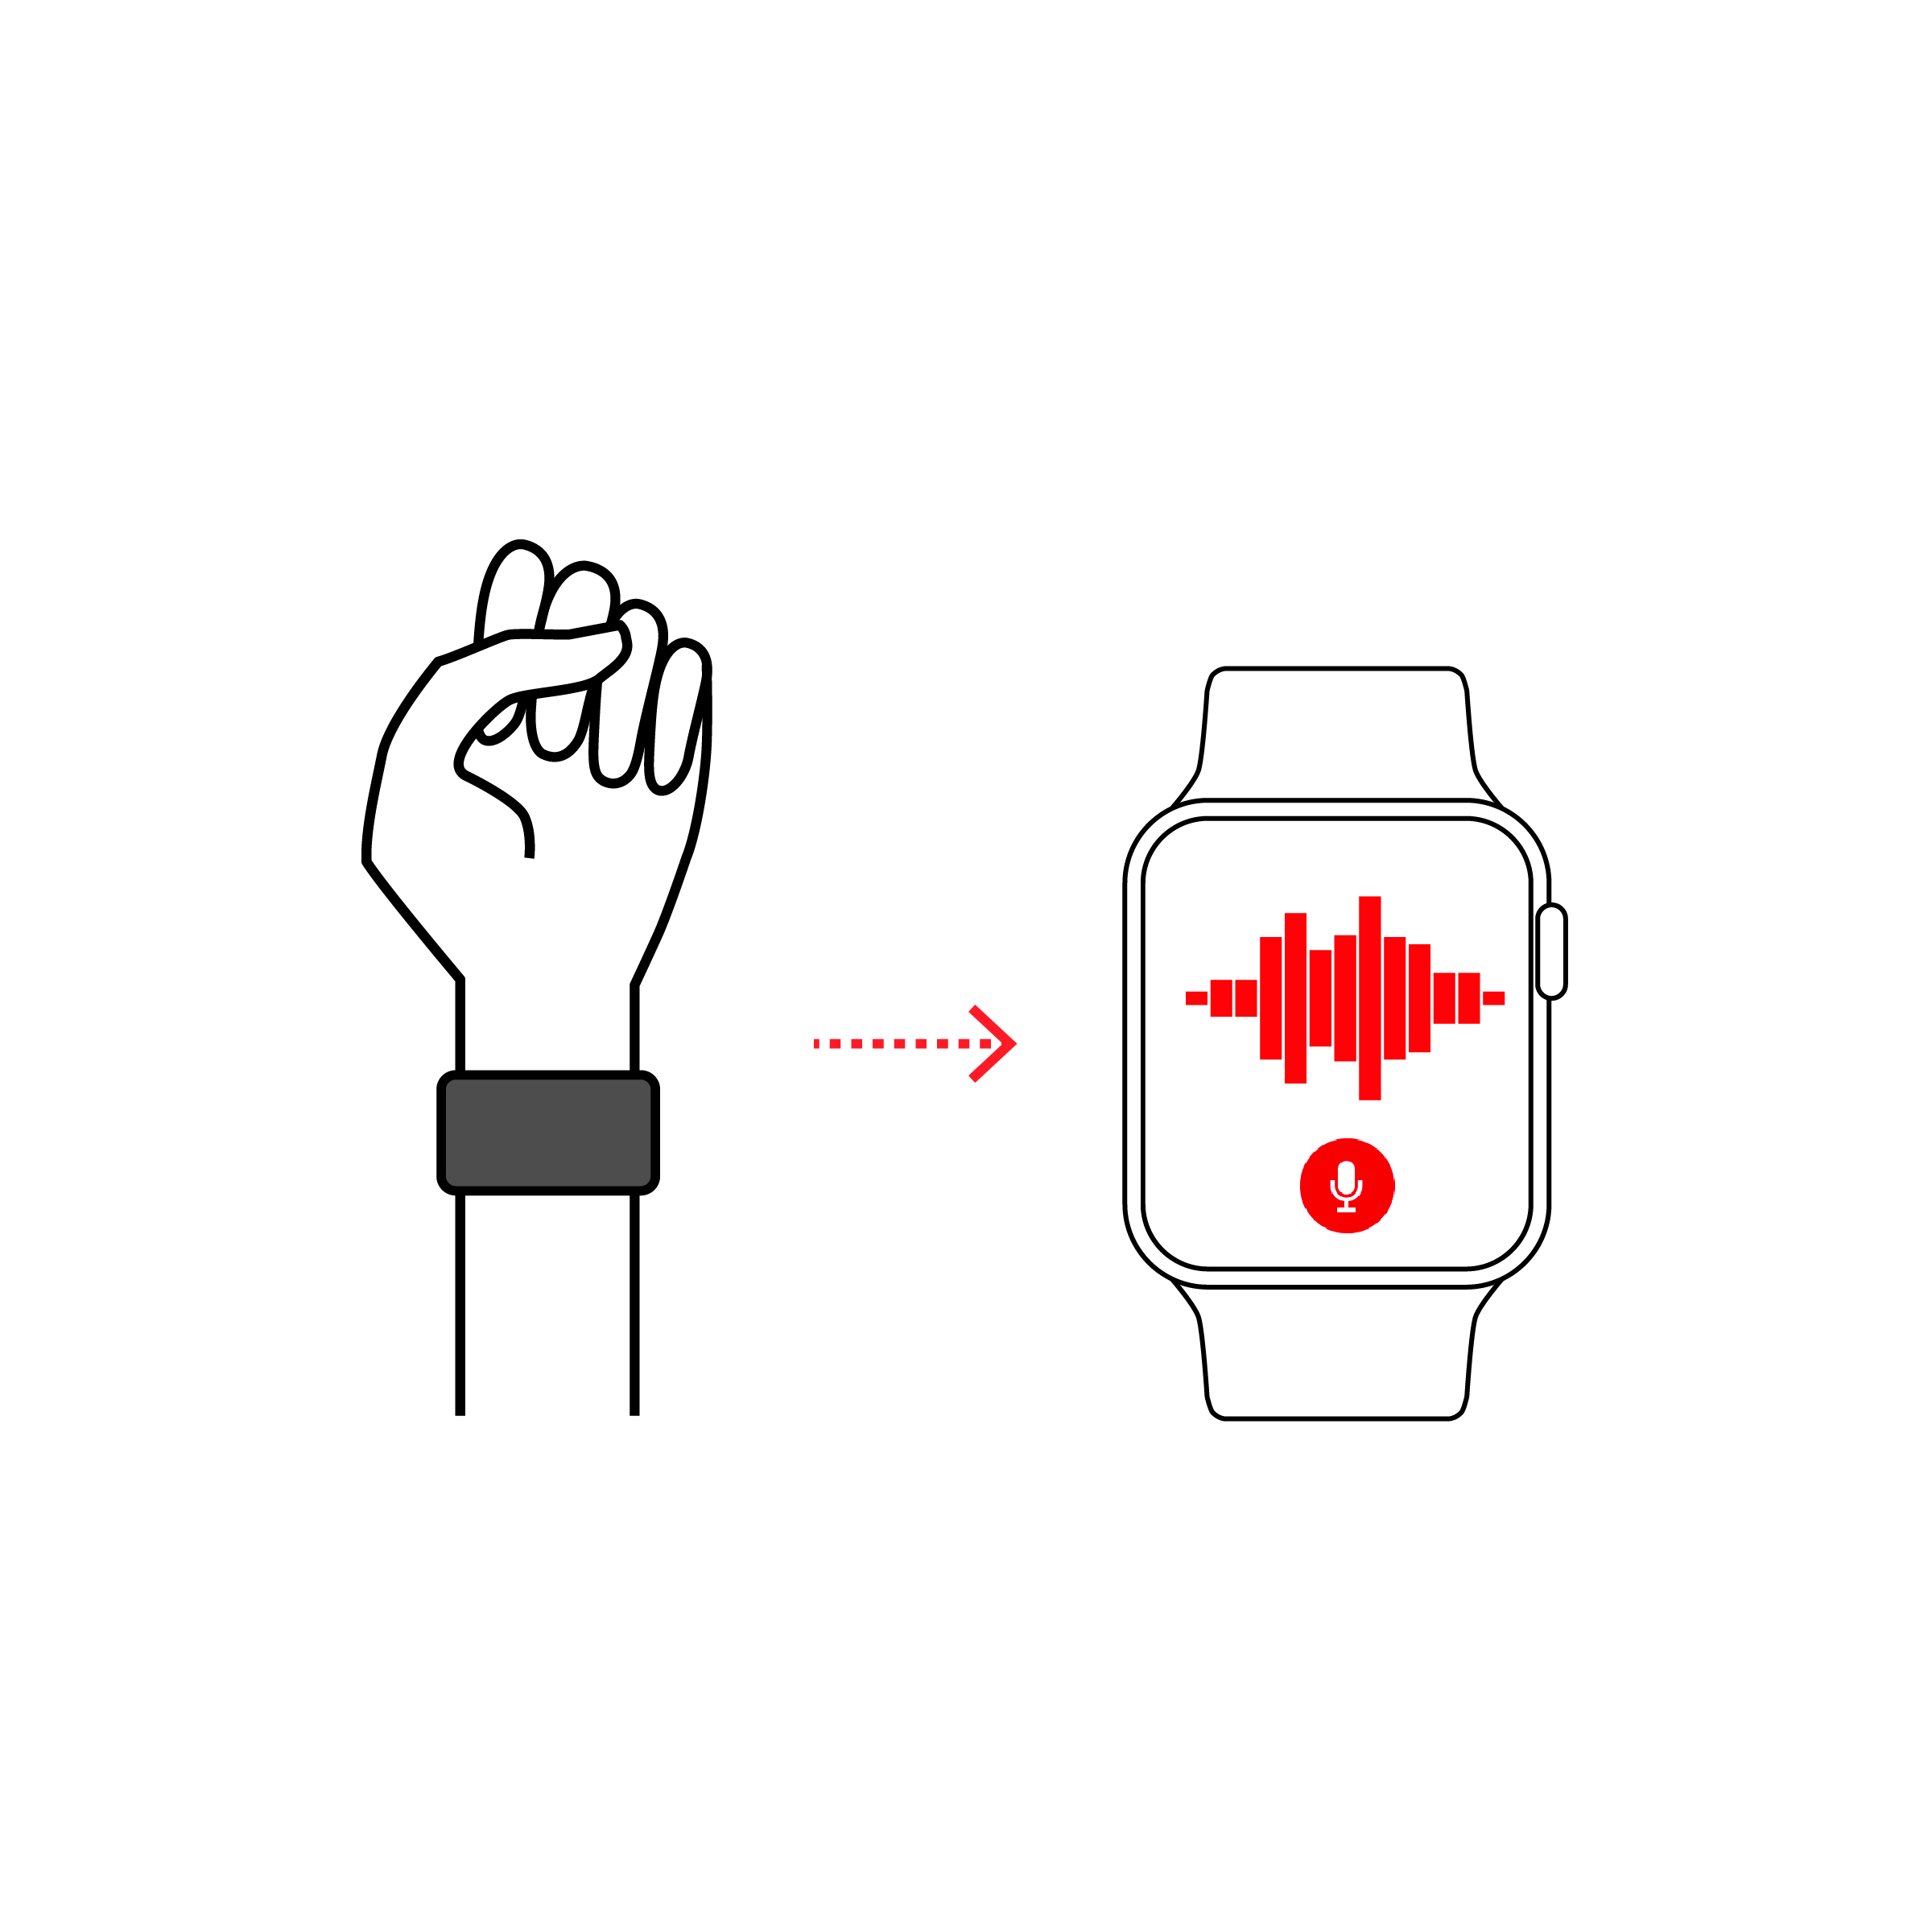
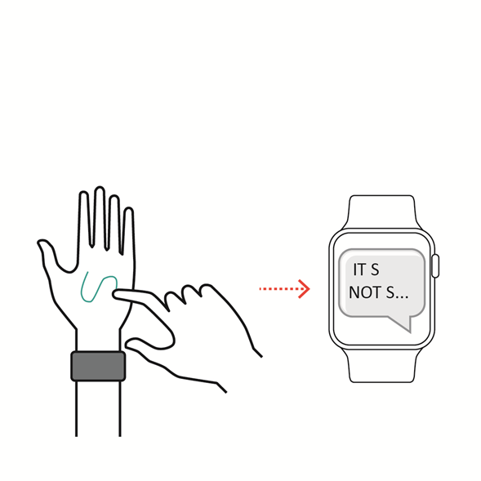
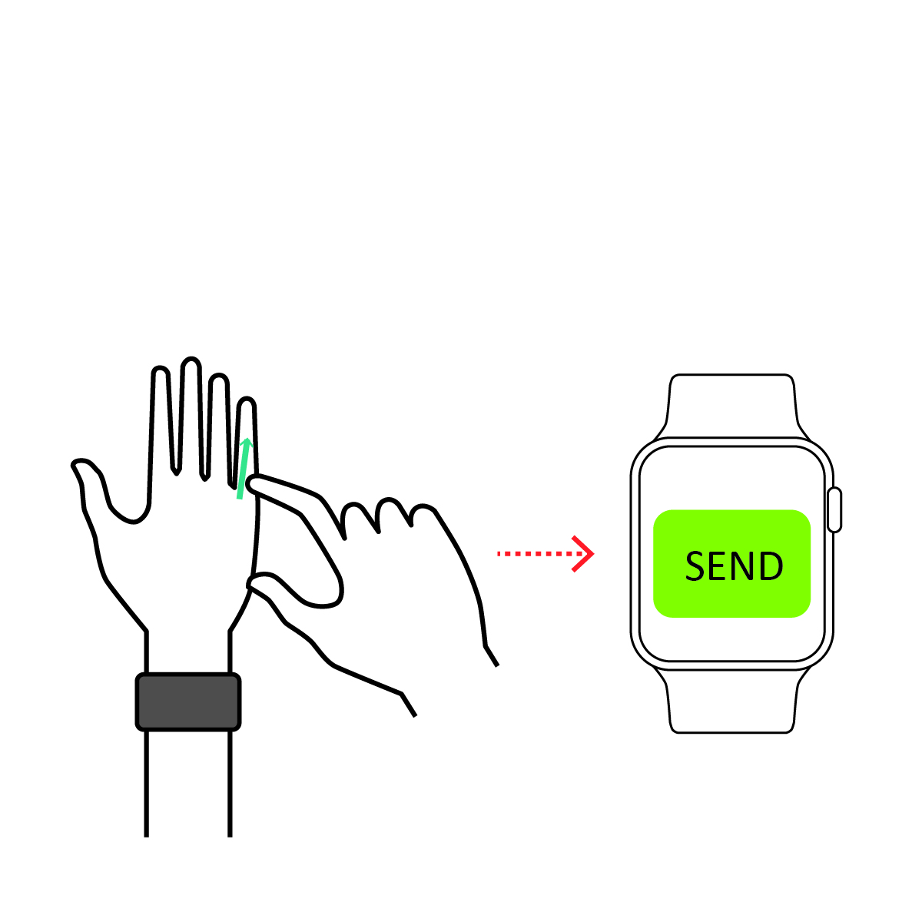
SKINPUT // Gestures + Features
Skinput Features :
Act without alerting the criminal
Fast with few motions needed
Safe for the situation
Requires little focus
Minimal physical effort required
Natural and discrete motions
Encouraging to use

Slide 7
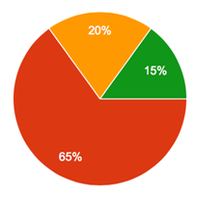
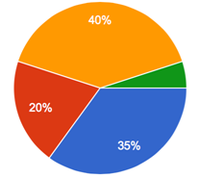
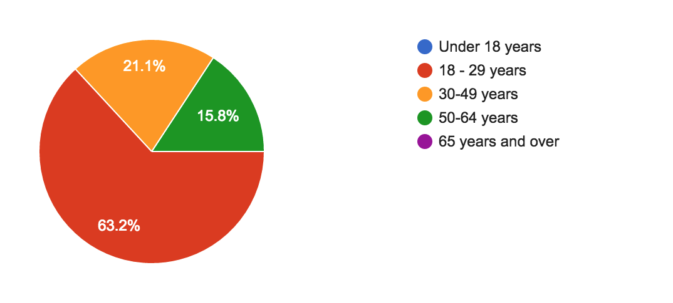
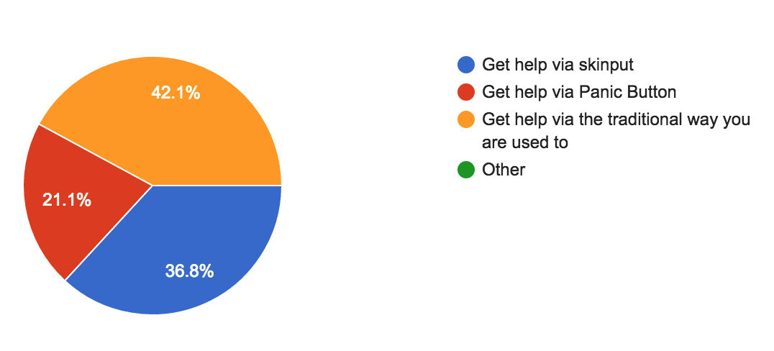
EVALUATION // RESULTS
What is your age?
If you want to get help in an emergency situation, which one do you prefer?
Need more diversity in age groups.
65% of participants were 18-29 years old.
40% prefer their traditional way they are used to getting help
Skinput was preferred over the Panic Button on the Mobile App.

Slide 8
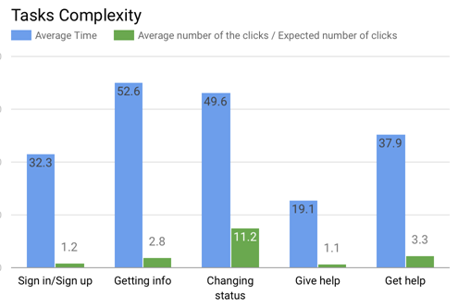
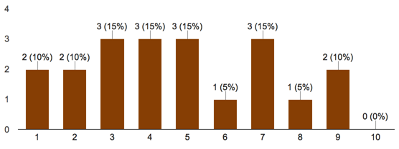
EVALUATION // RESULTS
How easy did you find the app to learn?
Task comparison metrics
Fairly continuous distribution of opinions about easy of learning
Users were not confident that they immediately understood how to use the app
“Give Help” task had the fewest errors and averaged the shortest amount of time for task completion

Slide 9
CONCLUSIONS
Use “Give Help” function to help redesign other features
Speed is most important, so any redesign should keep that in mind
Skinput demonstration was well-received and should definitely be integrated

Slide 10

Questions?

